Slide 1
Proactive Risk Based Alerting for Insider Threats
Splunk .conf21 Breakout Sessions

Slide 2

Matt Snyder
Program Lead – Advanced Security Analytics | VMware

Slide 4

Everyone has an Insider Threat Problem
No matter what industry you are in or the size of your company, you faces challenges from Insider Threats.

Slide 5
Remote work has accelerated risks
With workforces around the world shifting to remote/work from anywhere models, now most employees now have access to data from work and personal devices
% of Employees likely to leak data post COVID-10
85%
Source: https://www.code42.com/resources/report-2021-data-exposure/

Slide 6







Now its time to build a team!

Slide 7
You Need Support
Building strong partnerships is key!
Legal
HR/ER
Privacy
Physical Security
What issues are they concerned with, biggest threats they see.
What are you going to do when you have a case? How do they report a potential issue?
What can and can’t your program do?
Who are you going to call if things get ugly?

Slide 8
Life Cycle of Investigation
Before RBA and Splunk, the process was slow, time consuming, reactive!
Issue Reported
Wait for next case
Forensic Image acquired
Prepare Report
Review Data

Slide 9
Enter the Tools!
The Sales Rep promised this would solve all our problems!!
AV / EDR Policies
Optional brief description, 16pt
IDM
Optional brief description, 16pt
DLP Tools
Optional brief description, 16pt

Slide 10
Life Cycle of Investigation
With RBA and relevant logs, we can be proactive to address issues that would might never have been discovered in a way that is scalable and efficient.
Detections Created
Enjoy Nights and Weekends
RBA Alerts Enabled
Review Alerts
Prepare Report / Automate Response

Slide 11
Types of Insider Threats
Knowing is Half the Battle…
Data Thief
Saboteur
Spy
Data Hoarder
Oops
Goal is to take data to be used in their next role or to start a competing business
Looking for revenge and out to create chaos!
They are working with a foreign government to steal data
They keep all data from everything on personal drives/cloud storage
They accidentally leak data through misconfigurations or accidents

Slide 12

Where are your Risks?
There are 9 Risks in the photo, can you spot them all?

Slide 13
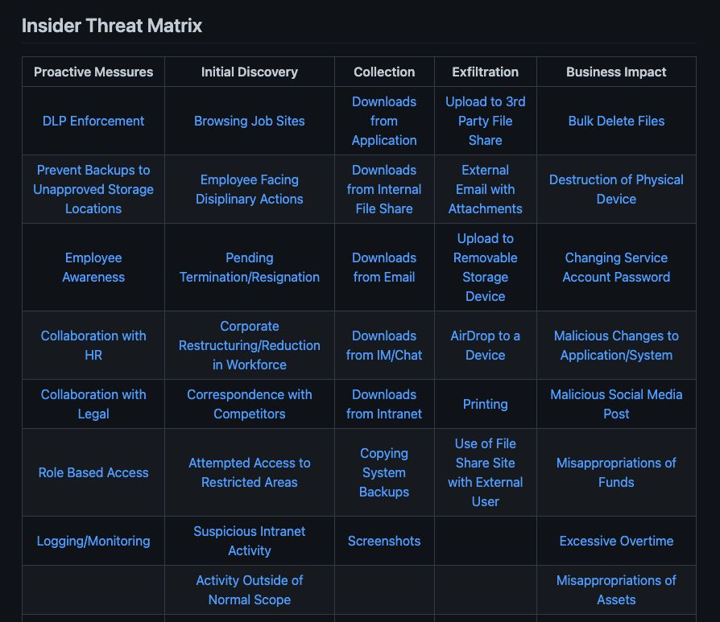
Identify what matters most
Stop hunting blindly
Insider Threats are not singular events, they are like to external threat actors, they follow a similar “attack” pattern. Source: https://github.com/Insider-Threat/Insider-Threat

Slide 14

Finding the Right Data
Insiders already have access to your environment; do you know what they are doing?
Network
Web Proxy Firewall
HR Data
SaaS / Online Storage
Orchestration
Critical Infrastructure
Endpoints EDR/NGAV
Identity and Access

Slide 15
Now its time to build stuff!!
Optional subtitle

Slide 16
Calculated Fields
High Risk File – key word-based list to help find files that might be sensitive
SPL:
if(match(file, "CONFIDENTIAL, Sensitive, Important_Stuff_In_Here"), "1”, "0")
1 = true and 0 = false
Competitors List– key word-based list to help find files related to Competitors
SPL:
if(match(file, ”Other_Company, Not_as_Good, Product_Stinks"), "1”, "0")
1 = true and 0 = false
More Info: https://docs.splunk.com/Documentation/Splunk/8.2.0/Knowledge/CreatecalculatedfieldswithSplunkWeb

Slide 17
Lookups
High Risk User – this is used for users that either have been identified as:
Behaving suspiciously
Part of a reduction in force (RIF)
Working on a sensitive project
Fields:
Username
Date added
Status – active or not_active
Notes
SPL:
index=risk | lookup high_risk_user.csv user as user OUTPUT hru_status notes date_added | search hru_status=”active”
Pro Tip - keep list access to the lookup limited!
Easy to update with the Lookup Editor app
More Info: https://docs.splunk.com/Documentation/SplunkCloud/latest/Knowledge/Usefieldlookupstoaddinformationtoyourevents

Slide 18
eventstats
eventstats - Generates summary statistics from fields in your events and saves those statistics in a new field.
SPL:
| eventstats avg(risk_score) as avg_risk stdev(risk_score) as stdev_risk
Get average risk scores and see how they compare with other users.
High Risk scores are great but don’t always capture everything
More Info: https://docs.splunk.com/Documentation/SplunkCloud/latest/SearchReference/Eventstats

Slide 19
eval
eval – one of the most powerful Splunk commands.
SPL:
| eval risk_score=if(in(user_prop, "CEO", "CFO", "COO", "Executive Vice President"), risk_mod_count+20,risk_score)
| eval risk_score=if(total_hvf >=1 AND total_hvf <=50, risk_mod_count+10,risk_score)
Great way to apply dynamic scores based on your needs.
More Info: https://docs.splunk.com/Documentation/SplunkCloud/latest/SearchReference/Eval

Slide 20
where
where – The where command uses eval-expressions to filter search results. These eval-expressions must be Boolean expressions, where the expression returns either true or false.
SPL:
| where (risk_score>=55 AND total_hvf>=10 AND (tactic_exfil_value >=100 OR tactic_delete_value>=100))
Awesome way to help set your threshold and filter out noise
More Info: https://docs.splunk.com/Documentation/Splunk/8.2.1/SearchReference/Where

Slide 21
Risk Notable
Risk Notable – A correlation search with a Notable Event attached.
SPL:
index=risk | lookup high_risk_user.csv user as user OUTPUT hru_status notes date_added | search hru_status=”active” | eval risk_score=if(in(user_prop, "CEO", "CFO", "COO", "Executive Vice President"), risk_mod_count+20,risk_score)
| eval risk_score=if(total_hvf >=1 AND total_hvf <=50, risk_mod_count+10,risk_score) | eval aa_tactic_exfil_value=case(aa_tactic == "Exfiltration", "1", aa_tactic == "Collection", "0", aa_tech == "Data_Destruction", "0")
| eval aa_tactic_delete_value=case(aa_tactic == "Exfiltration", "0", aa_tactic == "Collection", "0", aa_tech == "Data_Destruction", "1") | eventstats avg(risk_score) as avg_risk stdev(risk_score) as stdev_risk | stats dc(file) as file_count sum(hvf) as total_hvf values( aa_tactic) as aa _tactic values(aa_tech) as aa_tech by user | where (risk_score>=55 AND total_hvf>=10 AND (tactic_exfil_value >=100 OR tactic_delete_value>=100))

Slide 22
Helpful Links
Insider Threat Matrix: https://github.com/Insider-Threat/Insider-Threat
Code42 Insider Threat Report: https://www.code42.com/resources/report-2021-data-exposure/
RBA Talk:

Slide 23
Questions and Answers…

Slide 24
Thank You

